Slide 1

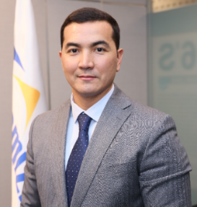

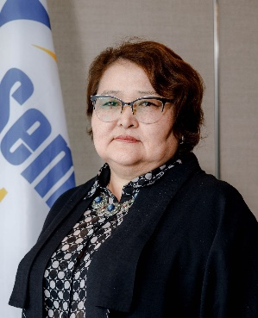
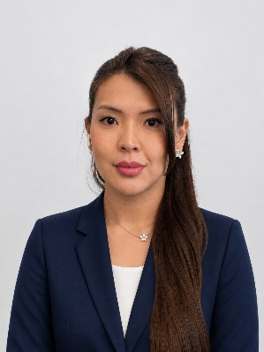
Succession Plan of Functional Pool Positions
General Director
Satanov Birzhan
TARGET POSITIONS
Director of HR Department
Director of Procurement Department
SUCCESSORS
Ukubayeva Aislu
Chief Manager of
HR Department
Nartbayeva Mennura
Director of Material & Technical supply department «Semizbay» mine

Slide 2
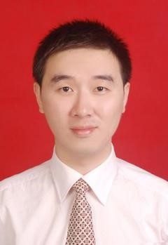
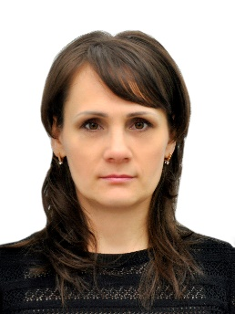
Succession Plan of Functional Pool Positions
Deputy General Director of Finance & Commercial Director
CUI YIWEN
TARGET POSITIONS
Chief Accountant
Accounting and Reporting Department
SUCCESSORS
Konovalova Vera
Deputy Director
Accounting and Reporting Department

Slide 3
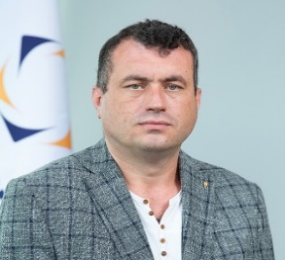
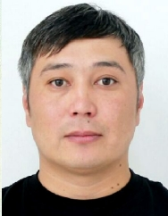
Succession Plan of Functional Pool Positions
Deputy General Director of Production
Zolin Alexey
TARGET POSITIONS
Director of Production and Geology Department
SUCCESSORS
Temenuly Zhomart
Director of «Semizbay» mine.

Slide 4
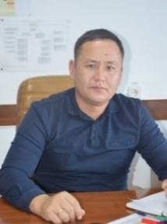
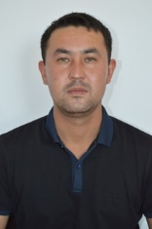
Succession Plan of Functional Pool Positions
Deputy General Director of Production
Zolin Alexey
TARGET POSITIONS
Director of the Mine / Branch
Chief Engineer of the Mine / Branch
SUCCESSORS
Kalymbetov Zharaskhan
Chief engineer of the branch
Nalibayev Timur
Head of the Production and Technical Service of «Irkol» Mine

