Slide 1

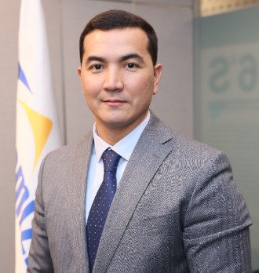
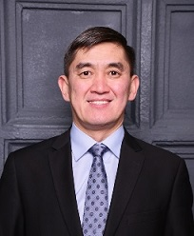
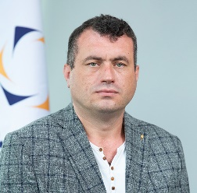
Management Pool Succession Plan
TARGET POSITIONS
Satanov Birzhan
General Director, “Semizbay-U” LLP
SUCCESSORS
READY WITHIN 1 YEAR
Berdigulov Almat,
Deputy General Director for Economics, “Semizbay-U” LLP
READY WITHIN 1-3
YEAR
Zolin Alexey,
Deputy General Director for Production, “Semizbay-U” LLP

Slide 2


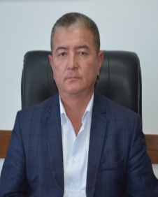
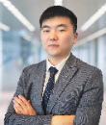
Management Pool Succession Plan
TARGET POSITIONS
Zolin Alexey
Deputy General Director for Production, “Semizbay-U” LLP
SUCCESSORS
READY WITHIN 1
YEAR
Salkynbayev Mukanbetzhan,
Director of the Irkol Branch, “Semizbay-U” LLP
Tsoi Bertan,
Director of the Production and Geology Department, “Semizbay-U” LLP
READY WITHIN 1-3
YEAR

Slide 3
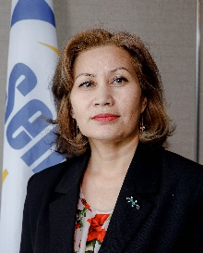
Management Pool Succession Plan
TARGET POSITIONS
Berdigulov Almat
Deputy General Director for Economics, “Semizbay-U” LLP
SUCCESSORS
READY WITHIN 1
YEAR
Zhaksybekova Meruyert,
Director of the Economics and Planning Department, “Semizbay-U” LLP

Slide 4
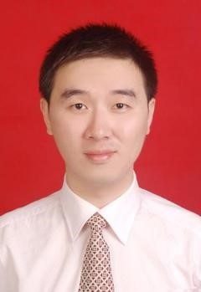
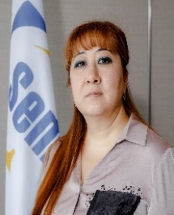
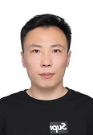
Management Pool Succession Plan
TARGET POSITIONS
Cui Yiwen
Deputy General Director, Finance and Commercial Director, “Semizbay-U” LLP
SUCCESSORS
READY WITHIN 1
YEAR
Sydygaliyeva Nyargul,
Chief Accountant, “Semizbay-U” LLP
READY WITHIN 1-3
YEAR
Liu Rongkang,
Category II Accountant, “Semizbay-U” LLP

Slide 5
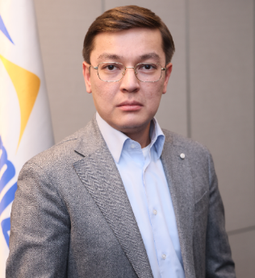
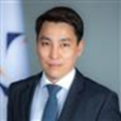
Management Pool Succession Plan
TARGET POSITIONS
Utyapov Kairat
Deputy General Director for Developing, “Semizbay-U” LLP
SUCCESSORS
Imankulov Samat,
Director of the Development and Business Administration Department, “Semizbay-U” LLP
READY WITHIN 1
YEAR

